Slide 1


PREXII/CREX Update:
Neutron Skin Measurements of ²⁰⁸Pb and ⁴⁸Ca through Parity Violation in Electron Scattering
Sanghwa Park (Stony Brook)
for the PREX/CREX Collaboration
Contact persons:
PREX: Kent Paschke CREX: Seamus Riordan

Slide 2
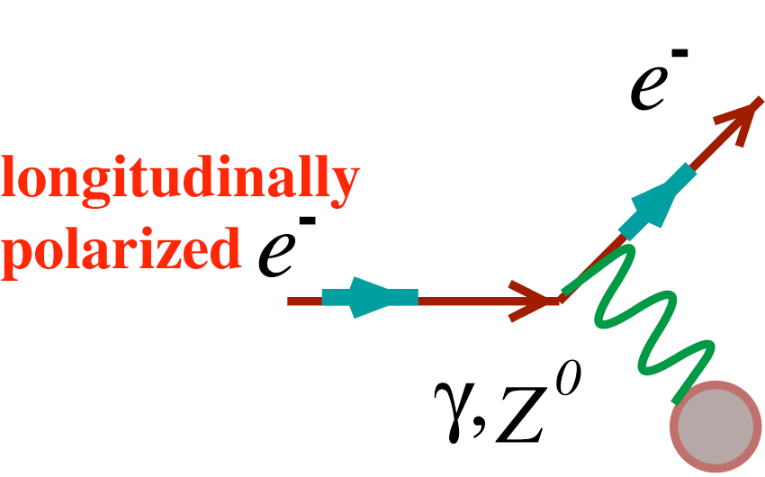
Introduction
Parity violating cross section asymmetry for longitudinally polarized electron - nucleus scattering
The asymmetry is proportional to the weak charge over the electromagnetic charge
unpolarized target
σ ∝ |Mγ + Mweak|²
~ |Mγ|² + 2Mγ(Mweak)* +…

Slide 3
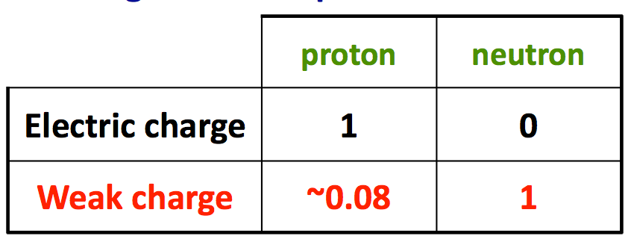
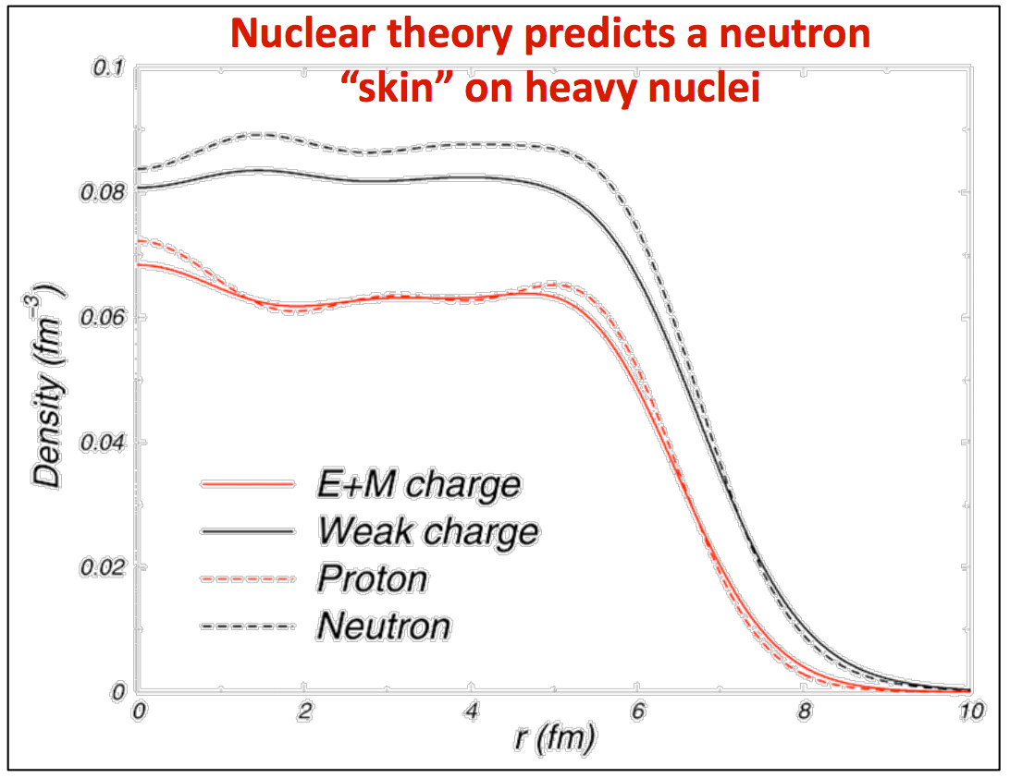
Introduction
Once we know the weak charge of a nucleus we can then easily make the connection to the neutron radius
Taking the difference between the well known electromagnetic radius (dominated by the protons) and the weak radius (dominated by the neutrons) we can find the “neutron skin” (Rn - Rp)
This quantity is fundamental to the nuclear equation of state and having a precise determination will lead to many implications across nuclear physics, for example the radius of neutron stars
²⁰⁸Pb

Slide 4
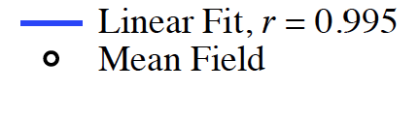
Introduction
Theory models predict A_{PV} and neutron skin thickness
Clear correlation shown between A_{PV} and the neutron skin from theoretical models

Slide 5
Introduction
Because of the large difference between the weak and electromagnetic form factors the asymmetry will be on the order of hundreds of part per billion.
This leads to the need for:
- Very high statistics (high electron current needed ~100 uA and integrating detectors). Will reach ~1GHz event rate.
- Very good control over all possible sources of systematic uncertainty

Slide 6
PREX I Result
Pb
A_{PV} = 0.657 ± 0.060(stat) ± 0.014(syst) ppm (210+ citations!)
PRL 108, 112502 (2012)
Seven mean-field models chosen to predict R_{n}(<A>)
First electroweak observation that there is a neutron skin around a heavy nucleus (Rn - Rp = 0.33 ^{+0.16} -0.18 )

Slide 7
PREX I Result
Pb
A_{PV} = 0.657 ± 0.060(stat) ± 0.014(syst) ppm (210+ citations!)
Helm
PRL 108, 112502 (2012)
ρ_{ch}
FSU
PRC 85, 032501(R) (2012)
First electroweak observation that there is a neutron skin around a heavy nucleus (Rn - Rp = 0.33 ^{+0.16} -0.18 )

Slide 8
PREXII and CREX
PREXII (²⁰⁸Pb)
  increase the precision by factor of 3
  collimator, shielding, target chamber upgrade
CREX (⁴⁸Ca)
  Measurement of the neutron skin of 48Ca with a precision of 0.02fm
  larger weak charge leads to greater sensitivity to Rn
  bridge ab-initio theoretical approaches and the nuclear density functional theory

Slide 9

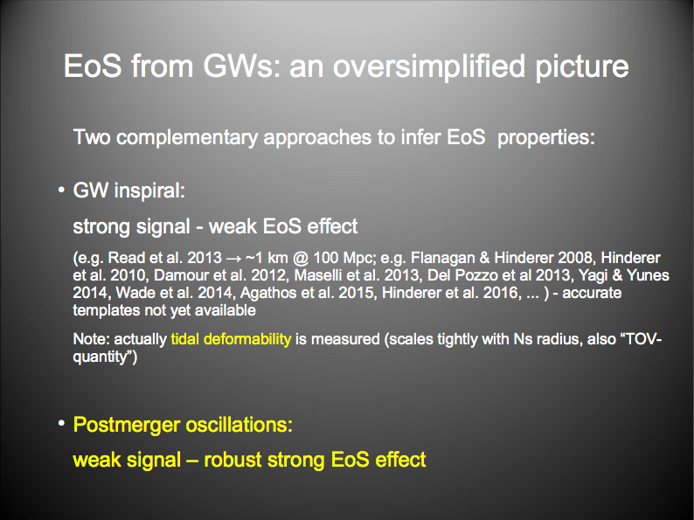
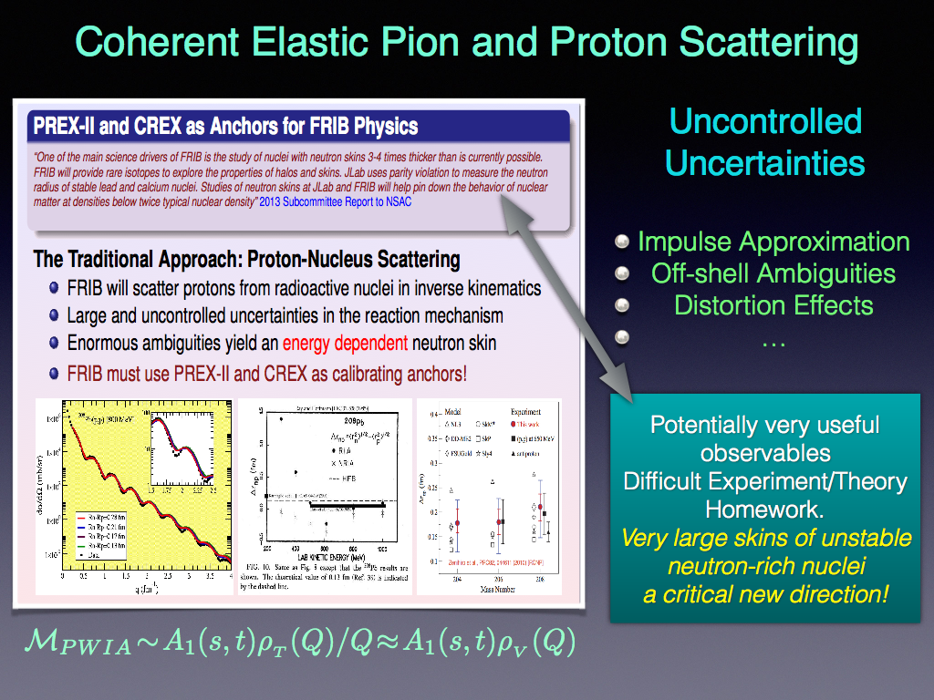
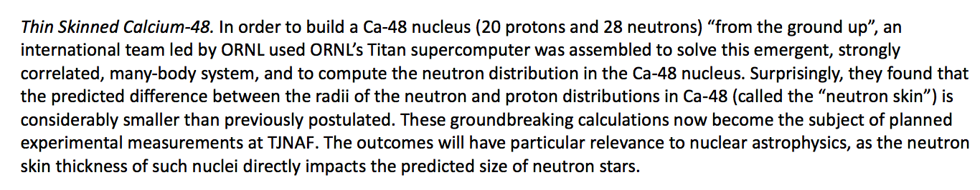
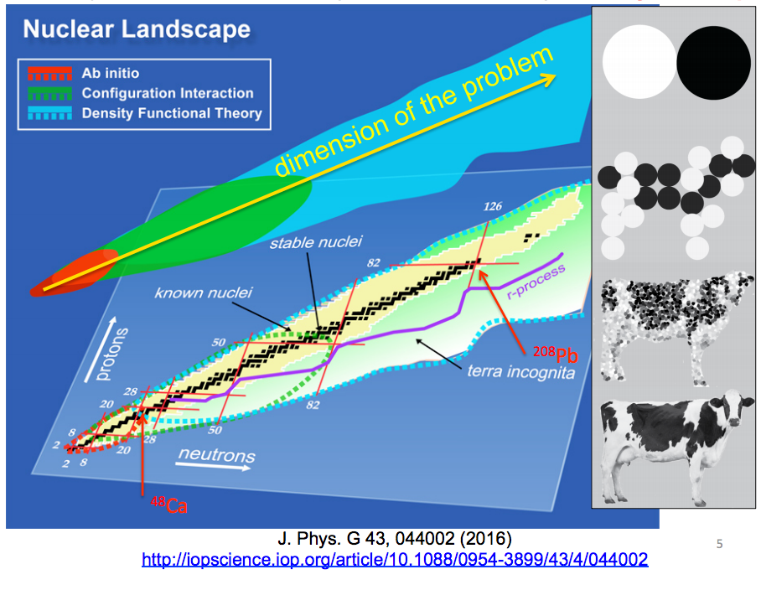
President’s 2017/2018 Budget request:
J. Piekarewicz

Slide 10
PREXII/CREX systematic budget
PREX-2: 3% stat, 0.06 fm
CREX: 2% stat, 0.02fm
PREX-II
E=1.1 GeV, 5º
A=0.6 ppm
70 μA, 25+10 days
CREX
E=1.9 GeV, 5º
A = 2.28 ppm
150 μA, 35 + 10 days
PREX-I
E=1.1 GeV, 5º
A=0.6 ppm
Charge Normalization | 0.2%
Beam Asymmetries | 1.1%
Detector Non-linearity | 1.2%
Transverse Asym | 0.2%
Polarization | 1.3%
Target Backing | 0.4%
Inelastic Contribution | <0.1%
Effective Q² | 0.5%
Total Systematic | 2.1%
Total Statistical | 9%
Charge Normalization | 0.1%
Beam Asymmetries* | 1.1%
Detector Non-linearity* | 1.0%
Transverse Asym | 0.2%
Polarization* | 1.1%
Target Backing | 0.4%
Inelastic Contribution | <0.1%
Effective Q² | 0.4%
Total Systematic | 2%
Total Statistical | 3%
Charge Normalization | 0.1%
Beam Asymmetries | 0.3%
Detector Non-linearity | 0.3%
Transverse Asym | 0.1%
Polarization | 0.8%
Target Contamination | 0.2%
Inelastic Contribution | 0.2%
Effective Q² | 0.8%
Total Systematic | 1.2%
Total Statistical | 2%
Achieved
*Experience suggests that leading systematic errors can be improved beyond proposal
CREX more sensitive to Q² uncertainty than PREX
Rate, absolute precision is similar to HAPPEX-II

Slide 11
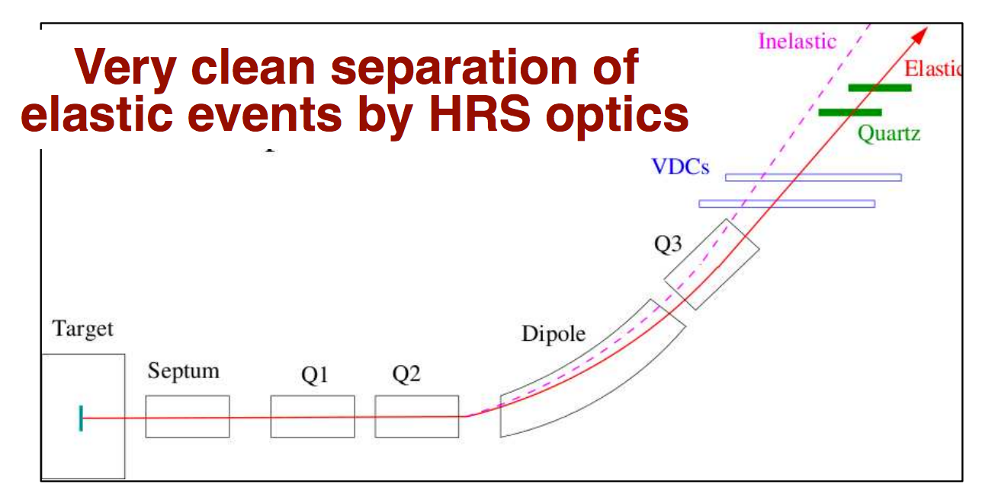
Experiment configuration
Simple polarized electron scattering experiment
unpolarized target
Scattering is mediated by γ and Z⁰
Use HRS arms to select the elastics scattering events and detect scattered electrons using quartz detectors
Analog integration of everything that hits the detector

Slide 12
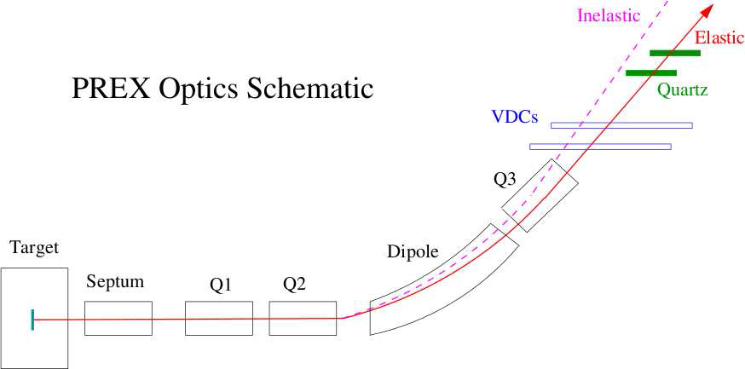
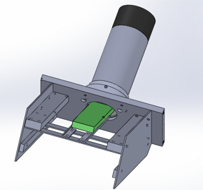

Experiment configuration
PREX-II quartz detector:
Tested at Mainz: RMS/Mean ~ 19%
Quartz detectors used as integrating detectors
New quartz detector design for PREX-II/CREX: significant improvement of the resolution
GEMs for tracking runs (Q² measurement)
PREX-I: RMS/Mean ~ 50%

Slide 13
ERR Updates
Experimental design has been frozen
  Single scattering position for ⁴⁸Ca and ²⁰⁸Pb (5 degree)
  Updated septum magnet requirements
  Updated shielding to protect hall electronics and minimize the boundary dose
Passed the Experimental Readiness Review (ERR)
Will make a beam request next month

Slide 14
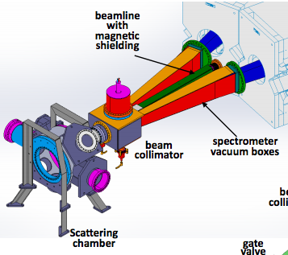
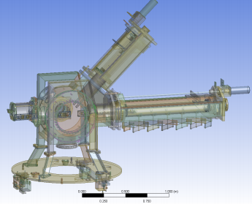
Scattering chamber
design by Silviu Covrig Dusa
optics arm
cryogenic arm
Single scattering position: 5 degrees
  PREX remains the same, CREX 4 → 5 degrees
simplified design, construction and installation (cost reduction)
FOM is about the same for for CREX, but easier measurement

Slide 15
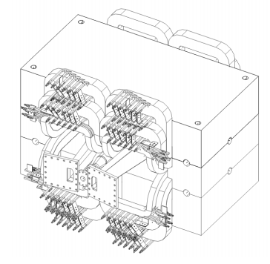
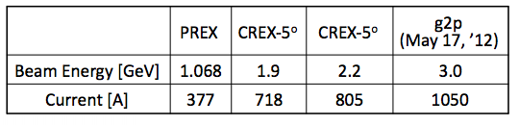
Septum magnet requirements
5 degree ⁴⁸Ca position decreases requirements on the septum (current, cooling)
Current calculation puts CREX running of the septum below g2p requirement

Slide 16
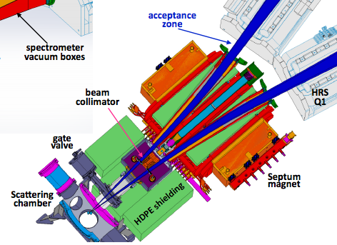
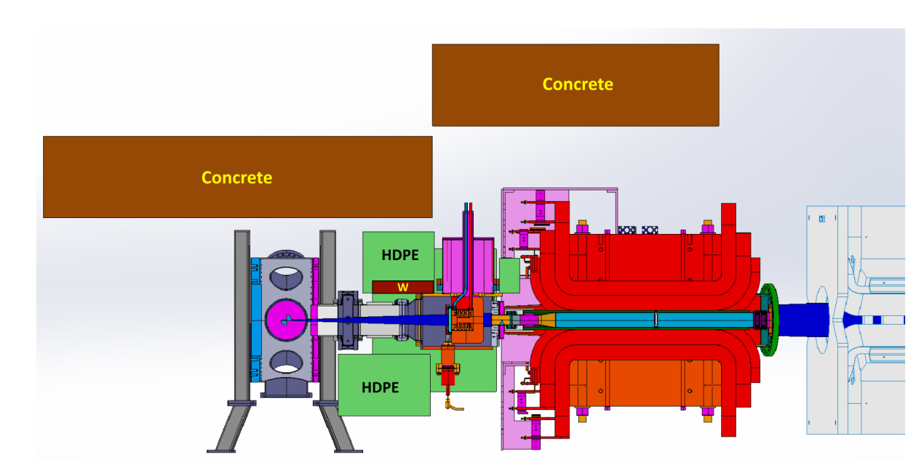
Shielding
Shielding optimized to reduce radiation dose inside the hall
collimator region surrounded by HDPE
Approximately 4 tons of concrete will be placed over the target and collimator region to minimize boundary dose

Slide 17
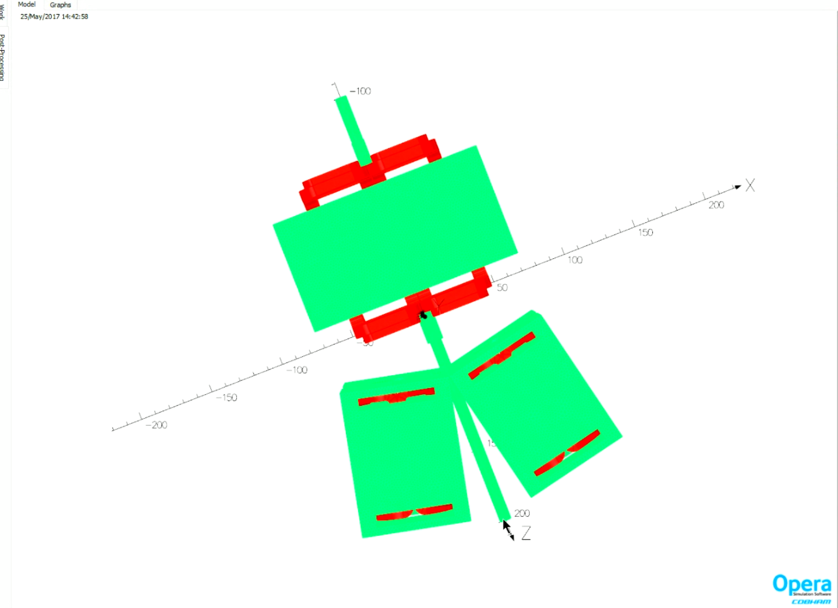
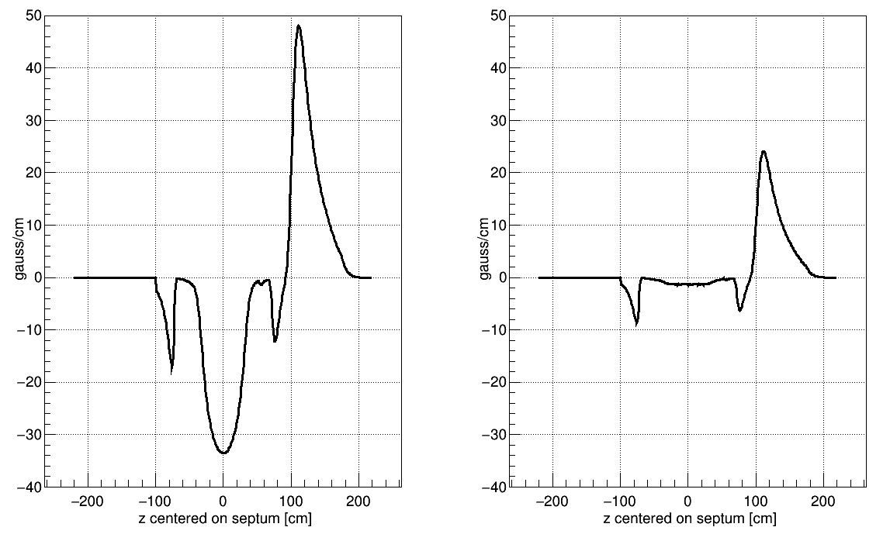
Fringe fields
CREX
PREX
Septum
Quads
Q1 fringe field is much less of a concern than we presented at the ERR
Realistic estimates with a full TOSCA model indicates radiation will increase by at most ~10% by leaving the Q1 region unshielded
  → There are shielding options for that region that will be easy to implement

Slide 18
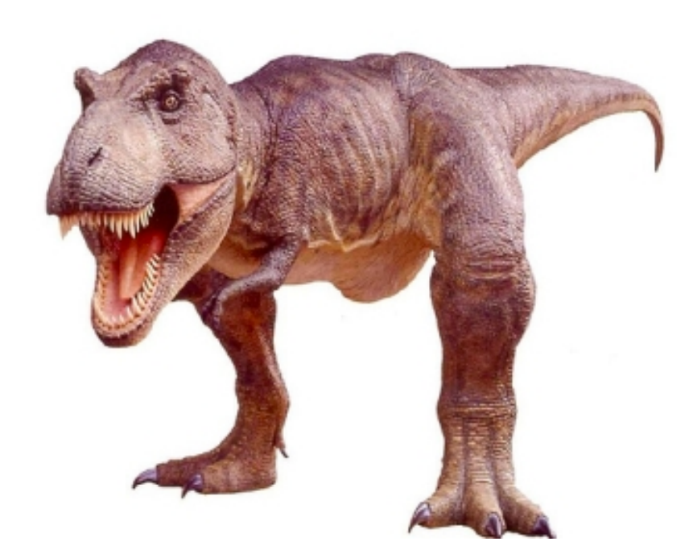

Summary
The collaboration has completed the key items needed to be considered for beam scheduling
  Documentation is being finalized so that we can be ready when the beam schedule request call comes out
Design has been frozen and new components are being built
Fringe fields are being thoroughly modeled using TOSCA
On track to be ready latter half of 2018!

